Slide 1
Chapter 2: Operating-System Structures

Slide 2
Outline
Operating System Services
User and Operating System-Interface
System Calls
System Services
Why Applications are Operating System Specific
Design and Implementation
Operating System Structure
Building and Booting an Operating System

Slide 3
Operating System Services
We can view OS from several points:
  The services that the OS provides
  The interface provided to users and programmers
  Its components and interconnections

Slide 4

A View of Operating System Services

Slide 5
Services to the user
User interface - Almost all operating systems have a user interface (UI)
  Varies between
  Command-Line (CLI) 命令行
  Graphics User Interface (GUI) 用户界面
  Batch 批处理
Program execution
  The system must be able to load a program into memory and to run that program, end execution, either normally or abnormally (indicating error)

Slide 6
Services to the user (Cont)
I/O operations
  A running program may require I/O, which may involve a file or an I/O device
File-system manipulation
  Obviously, programs need to read and write files and directories, create and delete them, search them, list file Information, permission management.

Slide 7
Services to the user (Cont)
Communications
  Processes may exchange information, on the same computer or between computers over a network
    Communications may be via shared memory or through message passing (packets moved by the OS)

Slide 8
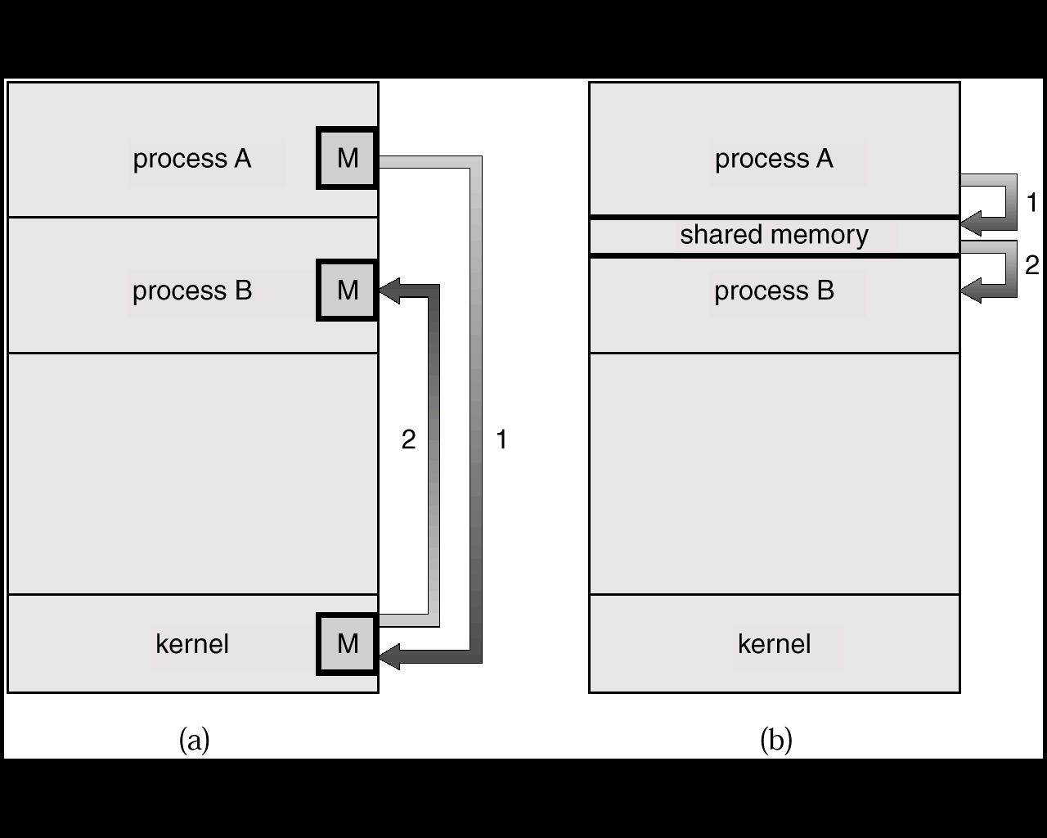
Communication Models
Msg Passing
Shared Memory

Slide 9
Services to the user (Cont)
Error detection – OS needs to be constantly aware of possible errors
  May occur in the CPU and memory hardware, in I/O devices, in user program
  For each type of error, OS should take the appropriate action to ensure correct （正确） and consistent （一致） computing
  Debugging facilities can greatly enhance the user’s and programmer’s abilities to efficiently use the system

Slide 10
Services for the System Itself
Resource allocation - When multiple users or multiple jobs running concurrently, resources must be allocated to each of them
  Many types of resources - Some (such as CPU cycles, main memory, and file storage) may have special allocation code, others (such as I/O devices) may have general request and release code
Accounting （统计） - To keep track of which users use how much and what kinds of computer resources

Slide 11
Services for the System Itself (Cont)
Protection and security - The owners of information stored in a multiuser or networked computer system may want to control use of that information, concurrent processes should not interfere with each other
  Protection involves ensuring that all access to system resources is controlled
  Security of the system from outsiders requires user authentication, extends to defending external I/O devices from invalid access attempts

Slide 12
User Operating System Interface
Command interface
  Command Line Interface (CLI) or command interpreter
  GUI interface
Program interface
  System call

Slide 13
User Operating System Interface - CLI
Command Line Interface (CLI) or command interpreter allows direct command entry
  Sometimes implemented in kernel, sometimes by systems program
  Sometimes multiple flavors implemented – shells
  Primarily fetches a command from user and executes it
    Sometimes commands built-in, sometimes just names of programs
      If the latter, adding new features doesn’t require shell modification

Slide 14
User Operating System Interface - GUI
User-friendly desktop interface
  Usually mouse, keyboard, and monitor
  Icons represent files, programs, actions, etc
  Various mouse buttons over objects in the interface cause various actions (provide information, options, execute function, open directory (known as a folder)
  Invented at Xerox PARC （1973）
施乐帕克研究中心，是施乐公司所成立的最重要的研究机构

Slide 15
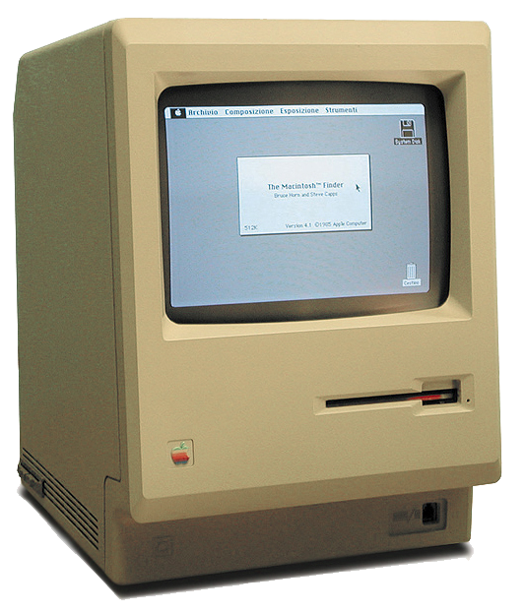
User Operating System Interface - GUI
Macintosh 128k
1984年

Slide 16
User Operating System Interface - GUI
Many systems now include both CLI and GUI interfaces
  Microsoft Windows is GUI with CLI “command” shell
  Apple Mac OS X as “Aqua” GUI interface with UNIX kernel underneath and shells available
  Solaris is CLI with optional GUI interfaces (Java Desktop, KDE)

Slide 17
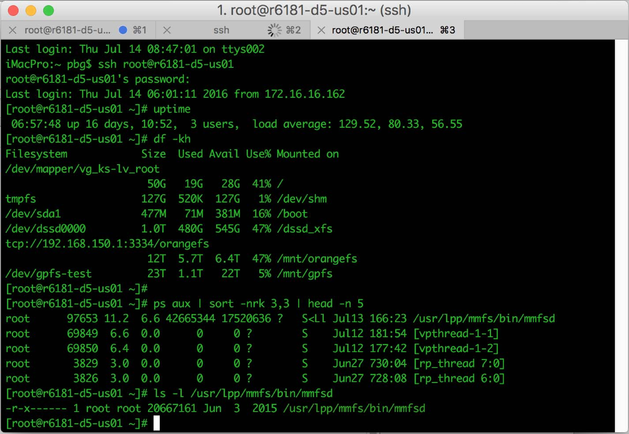
Bourne Shell Command Interpreter
Solaris 10 Bourne Shell

Slide 18
The Mac OS X GUI

Slide 19
System Calls
Programming interface to the services provided by the OS
Typically written in a high-level language (C or C++)
Mostly accessed by programs via a high-level Application Program Interface (API) rather than direct system call use
An API hides the details about system calls from programmers.

Slide 20
System Calls
Three most common APIs
  Win32 API for Windows
  POSIX API for POSIX-based systems (including virtually all versions of UNIX, Linux, and Mac OS X)
  Java API for the Java virtual machine (JVM)

Slide 21

Example of System Calls
System call sequence to copy the contents of one file to another file

Slide 22

Example of Standard API
Consider the ReadFile() function in the Win32 API—a function for reading from a file
A description of the parameters passed to ReadFile()
  HANDLE file—所要读取的文件
  LPVOID buffer—读进写出的数据缓冲
  DWORD bytesToRead—将要读入缓冲区的字节数
  LPDWORD bytesRead—上次读操作的字节数
  LPOVERLAPPED ovl—指示是否使用重叠I/O
fscanf, fread

Slide 23
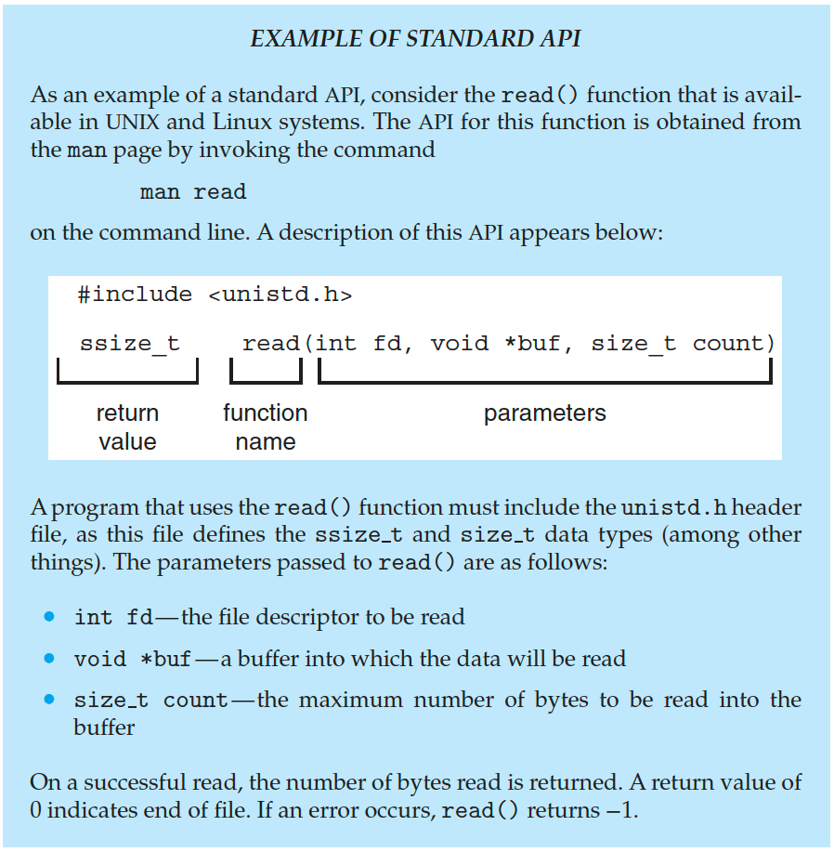
Example of Standard API

Slide 24

API – System Call – OS Relationship
INT

Slide 25
System Call Implementation
通常，每个系统调用一个与其相关的数字
  系统调用接口根据这些数字维护一个列表索引
When the user process executes the system call, the system call interface generates a software trap.
The CPU switches to kernel mode and the system call routine is executed (like interrupt).
  The system call interface invokes intended system call in OS kernel and returns status of the system call and any return values
The caller need know nothing about how the system call is implemented
  Just needs to obey API and understand what OS will do as a result call
  Most details of OS interface hidden from programmer by API
    Managed by run-time support library (set of functions built into libraries included with compiler)

Slide 26
System Call Parameter Passing
Three general methods used to pass parameters to the OS
  Simplest: pass the parameters in registers
    In some cases, may be more parameters than registers
  Parameters stored in a block, or table, in memory, and address of block passed as a parameter in a register
    This approach taken by Linux and Solaris
  Parameters placed, or pushed, onto the stack by the program and popped off the stack by the operating system
  Block and stack methods do not limit the number or length of parameters being passed

Slide 27
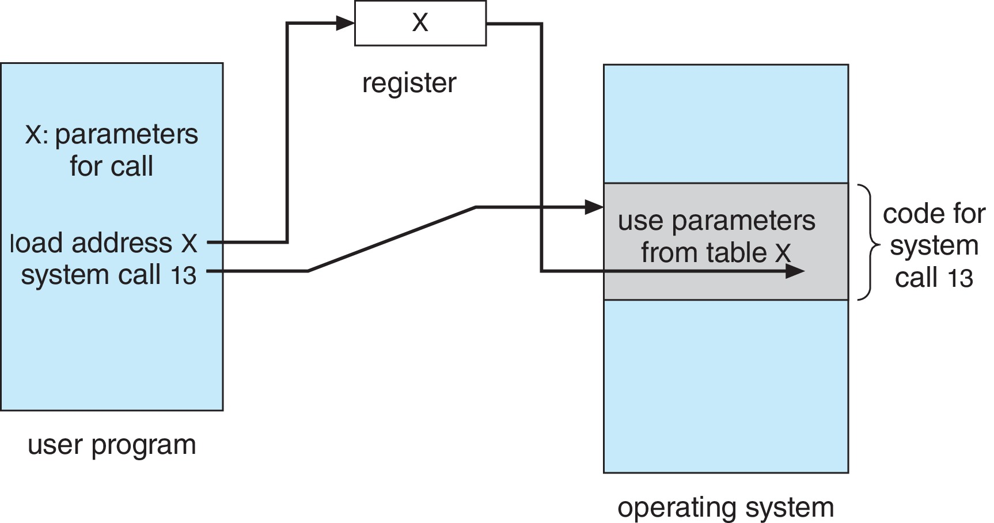
Parameter Passing via Table

Slide 28
Types of System Calls
Process control
  create process, terminate process
  end, abort
  load, execute
  get process attributes, set process attributes
  wait for time
  wait event, signal event
  allocate and free memory
  Dump memory if error
  Debugger for determining bugs, single step execution
  Locks for managing access to shared data between processes

Slide 29
Types of System Calls (Cont.)
File management
  create file, delete file
  open, close file
  read, write, reposition
  get and set file attributes
Device management
  request device, release device
  read, write, reposition
  get device attributes, set device attributes
  logically attach or detach devices

Slide 30
Types of System Calls (Cont.)
Information maintenance
  get time or date, set time or date
  get system data, set system data
  get and set process, file, or device attributes
Communications
  create, delete communication connection
  send, receive messages if message passing model to host name or process name
    From client to server
  Shared-memory model create and gain access to memory regions
  transfer status information
  attach and detach remote devices

Slide 31
Types of System Calls (Cont.)
Protection
  Control access to resources
  Get and set permissions
  Allow and deny user access

Slide 32
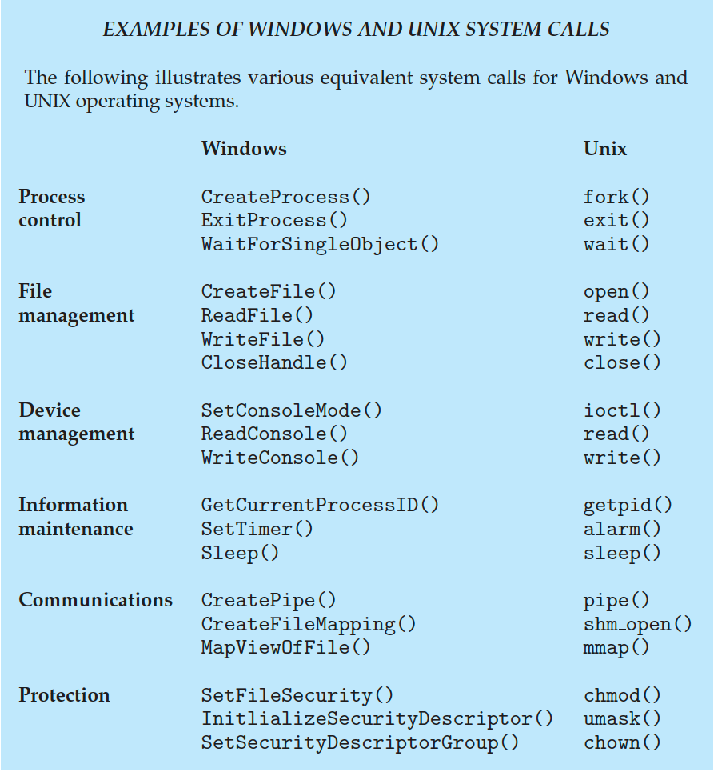
Examples of Windows and Unix System Calls

Slide 33
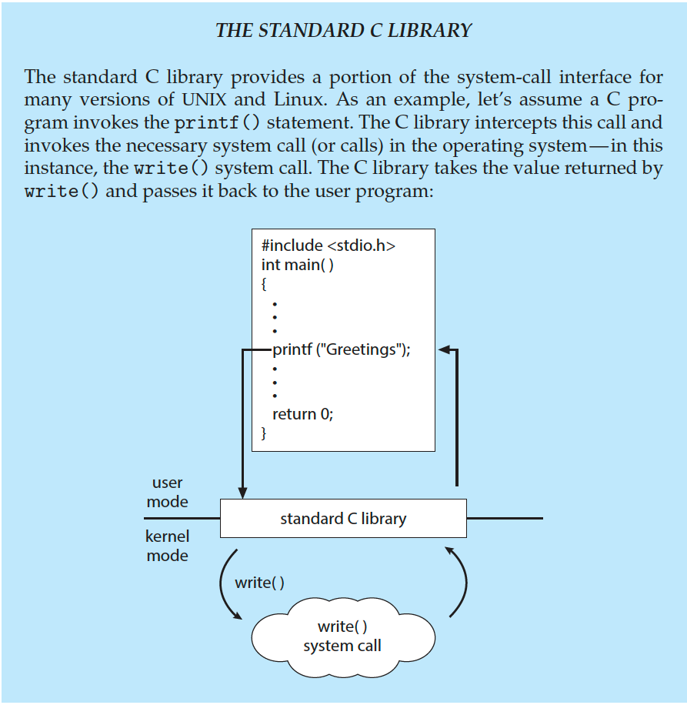
Standard C Library Example
C program invoking printf() library call, which calls write() system call

Slide 34
System Programs
也称为系统工具，提供一个方便的环境，以开发程序和执行程序
  一小部分 of them are simply user interfaces to system calls; others are considerably more complex
Most users’ view of the operation system is defined by system programs, not the actual system calls

Slide 35
System Programs
System programs can be divided into:
  File manipulation
  Status information
  File modification
  Programming language support
  Program loading and execution
  Communications

Slide 36
System Programs
File management - Create, delete, copy, rename, print, dump, list, and generally manipulate files and directories
Status information
  Some ask the system for info - date, time, amount of available memory, disk space, number of users
  Others provide detailed performance, logging, and debugging information
  Typically, these programs format and print the output to the terminal or other output devices
  Some systems implement a registry - used to store and retrieve configuration information

Slide 37
System Programs (cont)
File modification
  Text editors to create and modify files
  Special commands to search contents of files or perform transformations of the text
Programming-language support - Compilers, assemblers, debuggers and interpreters sometimes provided
Program loading and execution- Absolute loaders, relocatable loaders, linkage editors, and overlay-loaders, debugging systems for higher-level and machine language （一旦程序汇编或编译，必须装入内存才能执行）
Communications - Provide the mechanism for creating virtual connections among processes, users, and computer systems
  Allow users to send messages to one another’s screens, browse web pages, send electronic-mail messages, log in remotely, transfer files from one machine to another

Slide 38
Design and Implementation
Design and Implementation of OS is not “solvable”, but some approaches have proven successful
Internal structure of different Operating Systems can vary widely
Start the design by defining goals and specifications
Affected by choice of hardware, type of system
User goals and System goals
  User goals – operating system should be convenient to use, easy to learn, reliable, safe, and fast
  System goals – operating system should be easy to design, implement, and maintain, as well as flexible, reliable, error-free, and efficient
Specifying and designing an OS is highly creative task of software engineering

Slide 39
Implementation
Much variation
  Early OSes in assembly language
  Then system programming languages like Algol, PL/1
  Now C, C++
Actually usually a mix of languages
  Lowest levels in assembly
  Main body in C
  Systems programs in C, C++, scripting languages like PERL, Python, shell scripts
More high-level language easier to port to other hardware
  But slower
Emulation can allow an OS to run on non-native hardware

Slide 40
Operating System Structure
Simple Structure
Layered Approach
Microkernel System Structure
Modular Approach

Slide 41
Simple Structure
MS-DOS – written to provide the most functionality in the least space
  Not divided into modules
  Although MS-DOS has some structure, its interfaces and levels of functionality are not well separated

Slide 42

MS-DOS Layer Structure
系统驻留程序

Slide 43
Layered Approach
The operating system is divided into a number of layers (levels)
  each built on top of lower layers.
  The bottom layer (layer 0), is the hardware; the highest (layer N) is the user interface.
Each layer is a module, layers are selected such that each uses functions (operations) and services of only lower-level layers

Slide 44

Layered Operating System
自顶向下

Slide 45
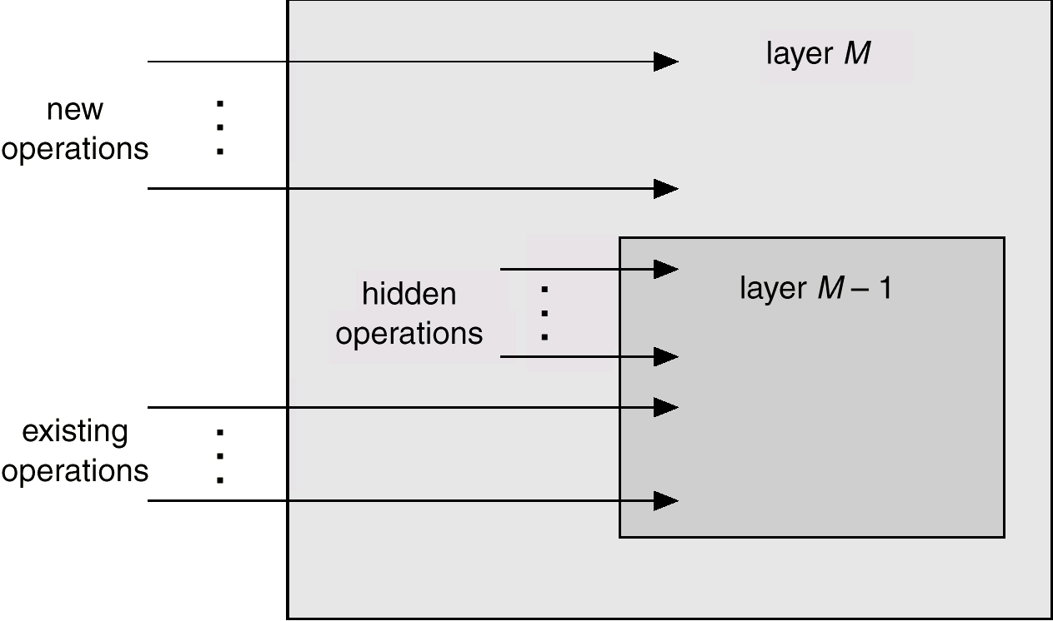
An Operating System Layer
操作系统层可抽象为对象来实现，
该对象包括数据和操作这些数据的操作。

Slide 46
Layered Approach
Layered rules：
  each layer only uses functions and services of lower-level layers
Difficulties
  How to layer
  How many layers

Slide 47

Traditional UNIX System Structure

Slide 48
Microkernel System Structure
Very small kernel
  Task scheduling
  Virtual memory management
  Interprocess communication
Support multiprocessing and distributed system
Based on Client/Server structure
  Massage passing

Slide 49
Microkernel OS
(Client/server OS)
Kernel implements:
  Scheduling
  Virtual Memory Management
  Interprocess communication (IPC)
User-mode servers
Client
App
Memory
Server
Network
Server
Process
Server
File
Server
Display
Server
User Mode
Kernel Mode
request
Microkernel
reply
Hardware

Slide 50
Microkernel System Structure
Benefits:
  Easier to extend a microkernel
  Easier to port the operating system to new architectures
  More reliable (less code is running in kernel mode)
  More secure
Detriments:
  Performance overhead of user space to kernel space communication

Slide 51
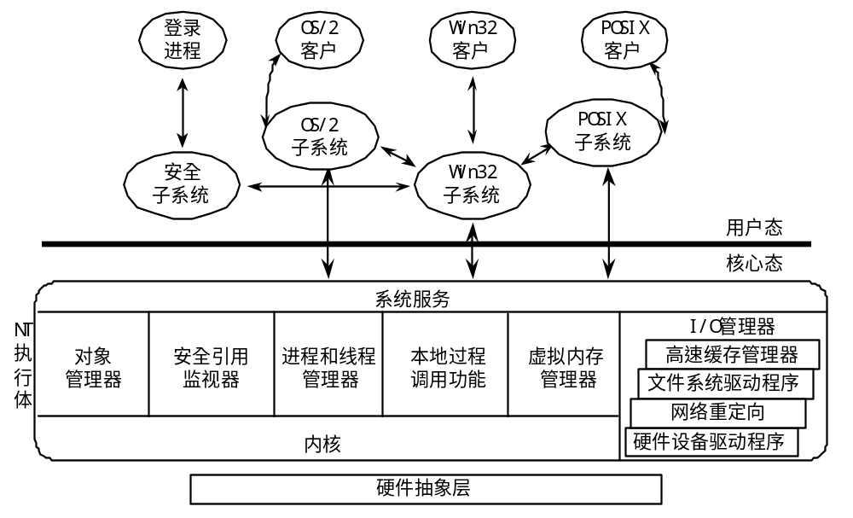
Windows NT Client-Server Structure
Windows NT体系结构

Slide 52
Modules
Most modern operating systems implement kernel modules
  Uses object-oriented approach
  Each core component is separate
  Each talks to the others over known interfaces
  Each is loadable as needed within the kernel
Overall, similar to layers but with more flexible

Slide 53

Solaris Modular Approach
杂项模块

Slide 54
Hybrid Systems
Most modern operating systems are not one pure model
  Hybrid combines multiple approaches to address performance, security, usability needs
  Linux and Solaris kernels in kernel address space, so monolithic, plus modular for dynamic loading of functionality
  Windows mostly monolithic, plus microkernel for different subsystem personalities
Apple Mac OS X hybrid, layered, Aqua UI plus Cocoa programming environment
  Below is kernel consisting of Mach microkernel and BSD Unix parts, plus I/O kit and dynamically loadable modules (called kernel extensions)

Slide 55
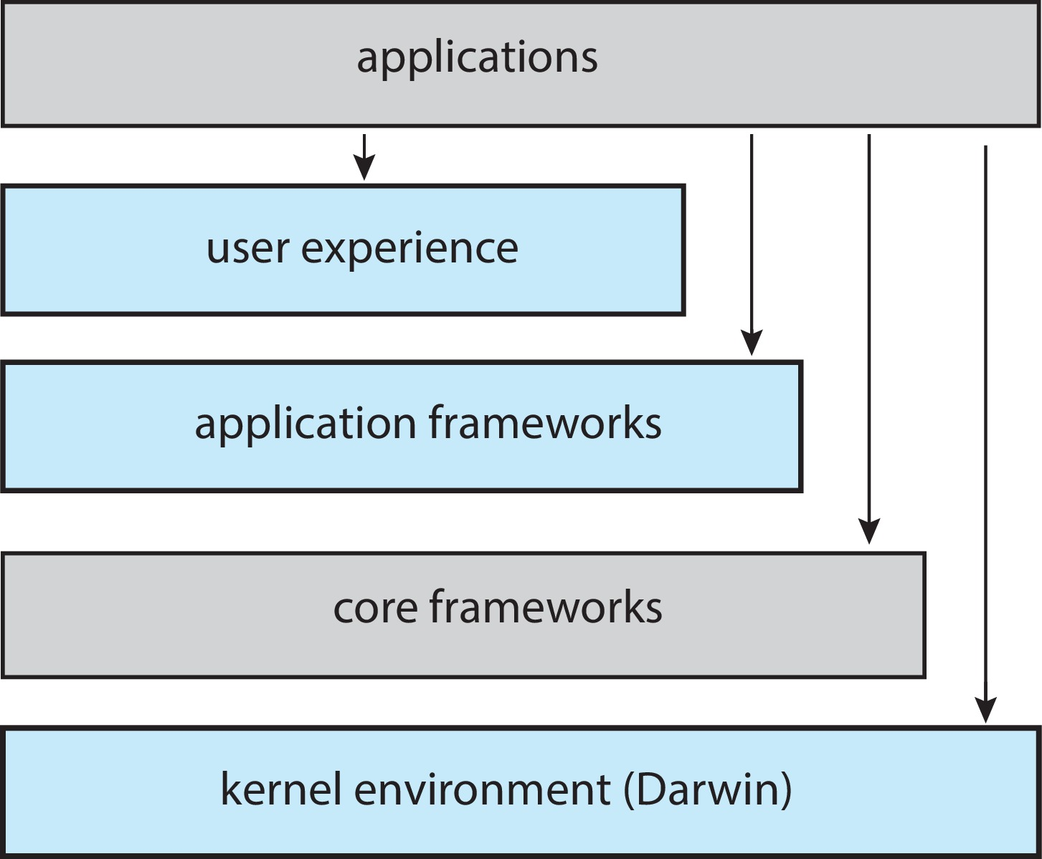
macOS and iOS Structure

Slide 56
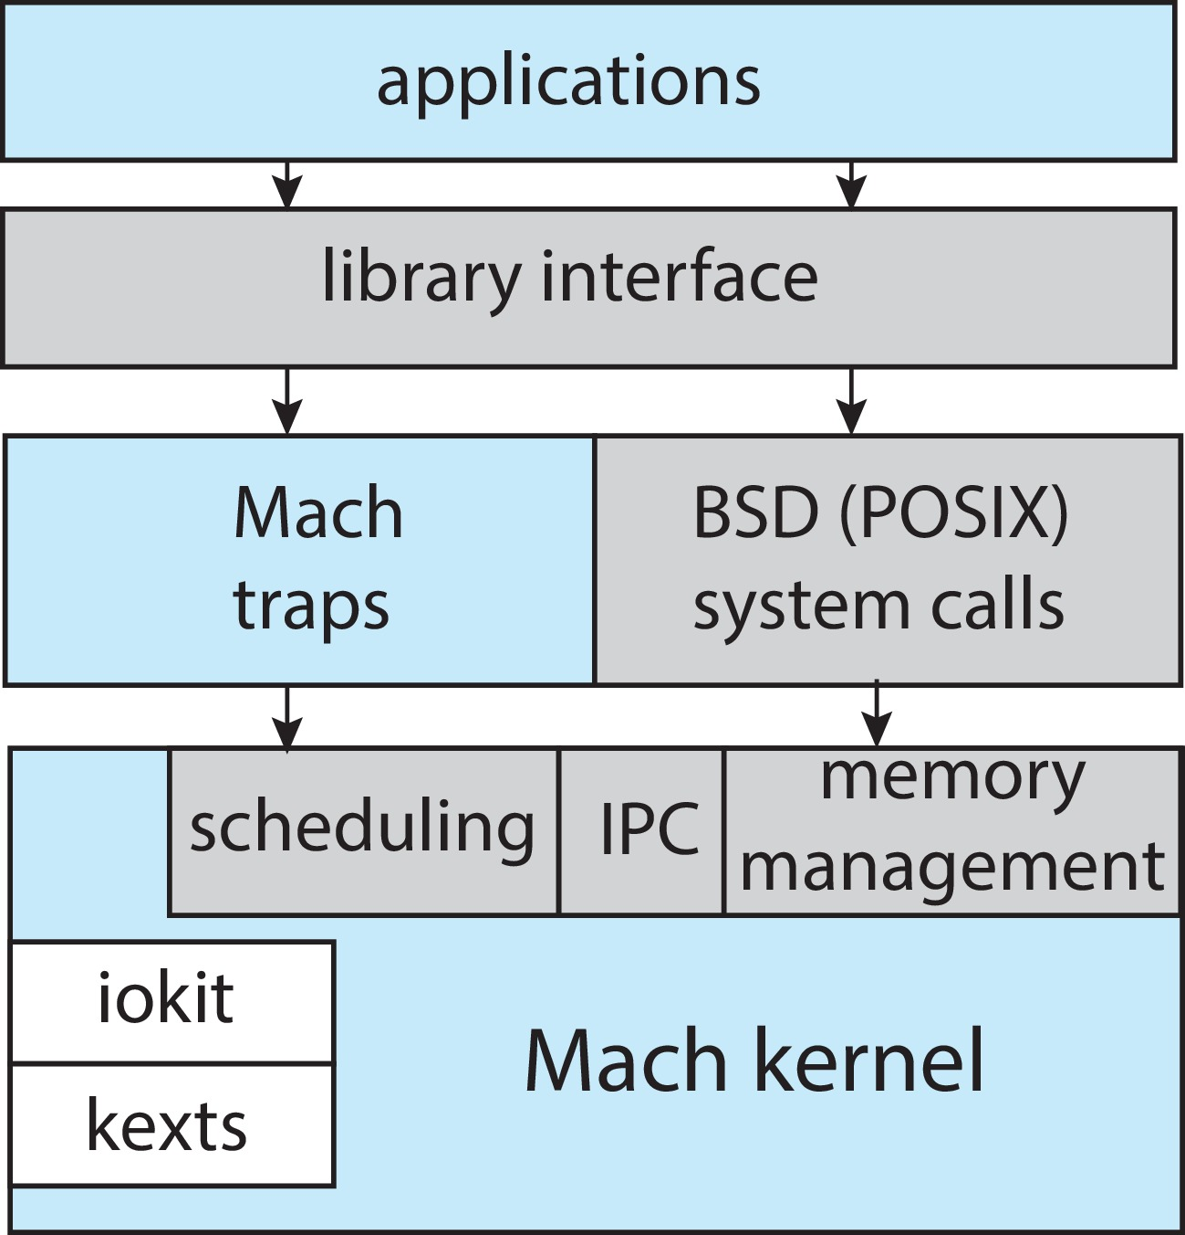
Darwin

Slide 57
Virtual Machines
A virtual machine takes the layered approach to its logical conclusion. It treats hardware and the operating system kernel as though they were all hardware
A virtual machine provides an interface identical to the underlying bare hardware
The operating system host creates the illusion that a process has its own processor and (virtual memory)
Each guest provided with a (virtual) copy of underlying computer

Slide 58
Virtual machine examples-IBM VM system
First appeared commercially in IBM mainframes in 1972
370Virtual Machine
System call
I/O
instruction
Trap
CMS
CMS
CMS
Trap
VM/370
370裸机
纯粹以虚拟机思想构造的OS体系结构，典型代表就是IBM大型机上的OS/370/390/400 系列操作系统。
设计思想：分时系统应该1. 多道程序2.一个比裸机更方便扩展的计算机，该系统能够向上层提供若干台虚拟机。

Slide 59
Benefits of Virtual Machines
The virtual-machine concept provides complete protection of system resources since each virtual machine is isolated from all other virtual machines. This isolation, however, permits no direct sharing of resources.
A virtual-machine system is a perfect vehicle for operating-systems research and development. System development is done on the virtual machine, instead of on a physical machine and so does not disrupt normal system operation.

Slide 60

Virtual Machines (Cont)
(a) Nonvirtual machine (b) virtual machine
Non-virtual Machine
Virtual Machine

Slide 61
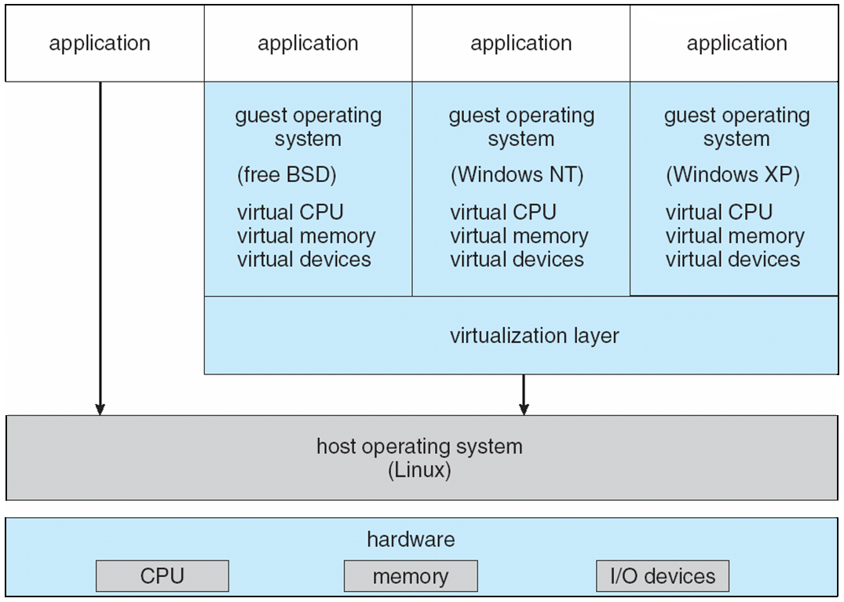
VMware Architecture
虚拟层是VMware的核心,它对物理硬件进行抽象,形成独立的运行不同guest OS的虚拟机

Slide 62
Operating System Generation
Operating systems are designed to run on any of a class of machines; the system must be configured for each specific computer site
SYSGEN program obtains information concerning the specific configuration of the hardware system
  What CPU is to be used?
  How much memory is available?
  What devices are available?
  What OS options are desired?
    Buffer size
    CPU-scheduling algorithm
    Maximum number of processes to be supported
    And so on

Slide 63
System Boot
Booting – starting a computer by loading the kernel
Finished by Bootstrap program
Bootstrap program – code stored in ROM that is able to locate the kernel, load it into memory, and start its execution

Slide 64
System Boot
The Bootstrap program can perform a variety of tasks
  Run diagnostics to determine the state of the machine
  Initialize all aspects of the system, from CPU registers to device controllers and the contents of main memory
  Start the operating system

Slide 65
End of Chapter 2

